Slide 1
Incredible world of architectures

Slide 2
TABLE OF ARCHITECTURE
01
02
03
04
RISC
CISC
ARM || BAIKAL || MIPS || POWER
X86 || AMD
VLIW
AMD64
Elbrus
AMD

Slide 3
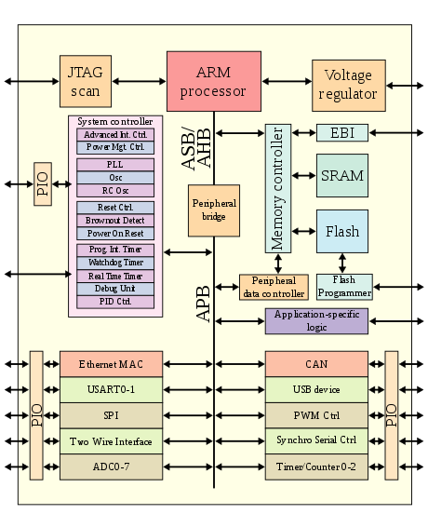
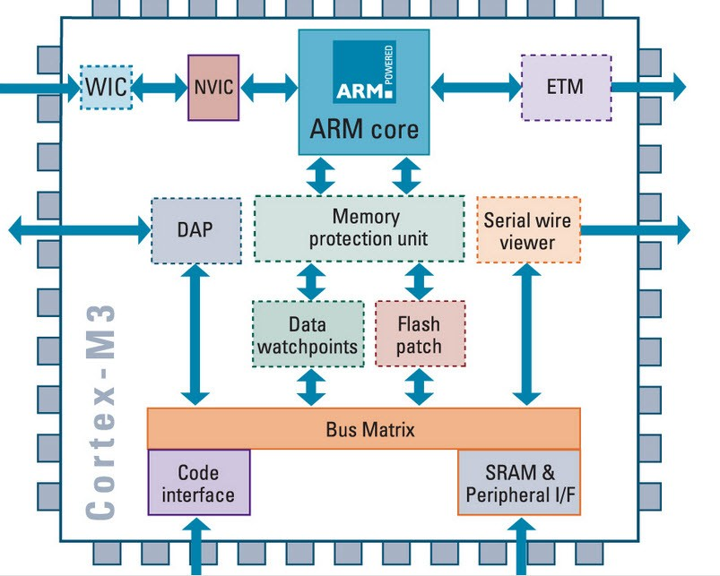
INTRODUCTION

Slide 4
Benefits of RISC
x86
MOV AX, 15; AH=00, AL=0Fh
AAA; AH=01, AL=05
RET
ARM
MOV-R3 #10
AND R2, R0, #0xF
CMP R2, R3
IT LT
BLT elsebranch
AD R2. #6
ADD R1. #one
elsebranch:
END

Slide 5
PREVALENCE OF ARM
99%
8%
MOBILE PRODUCTS
SMARTPHONES AND OTHER
PC-MARKET
Apple M1 ARCHITECTURE
ARM-PC

Slide 6
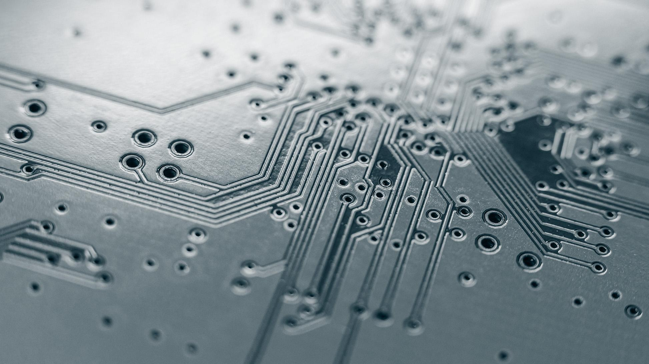
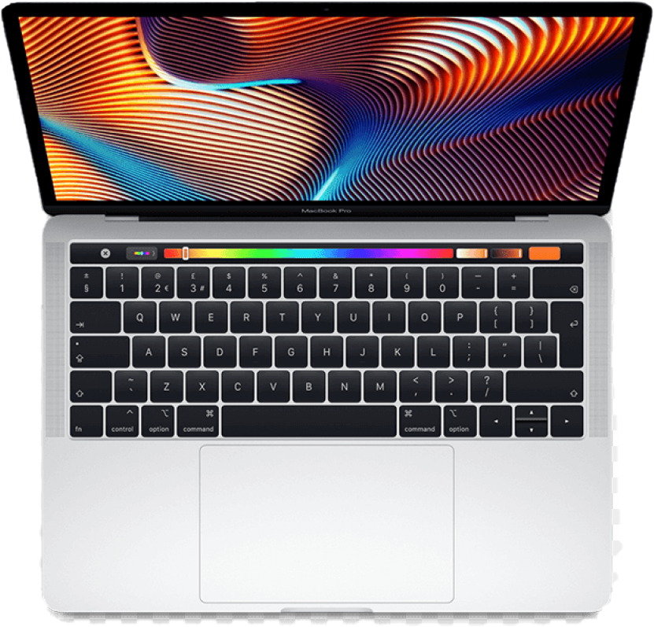

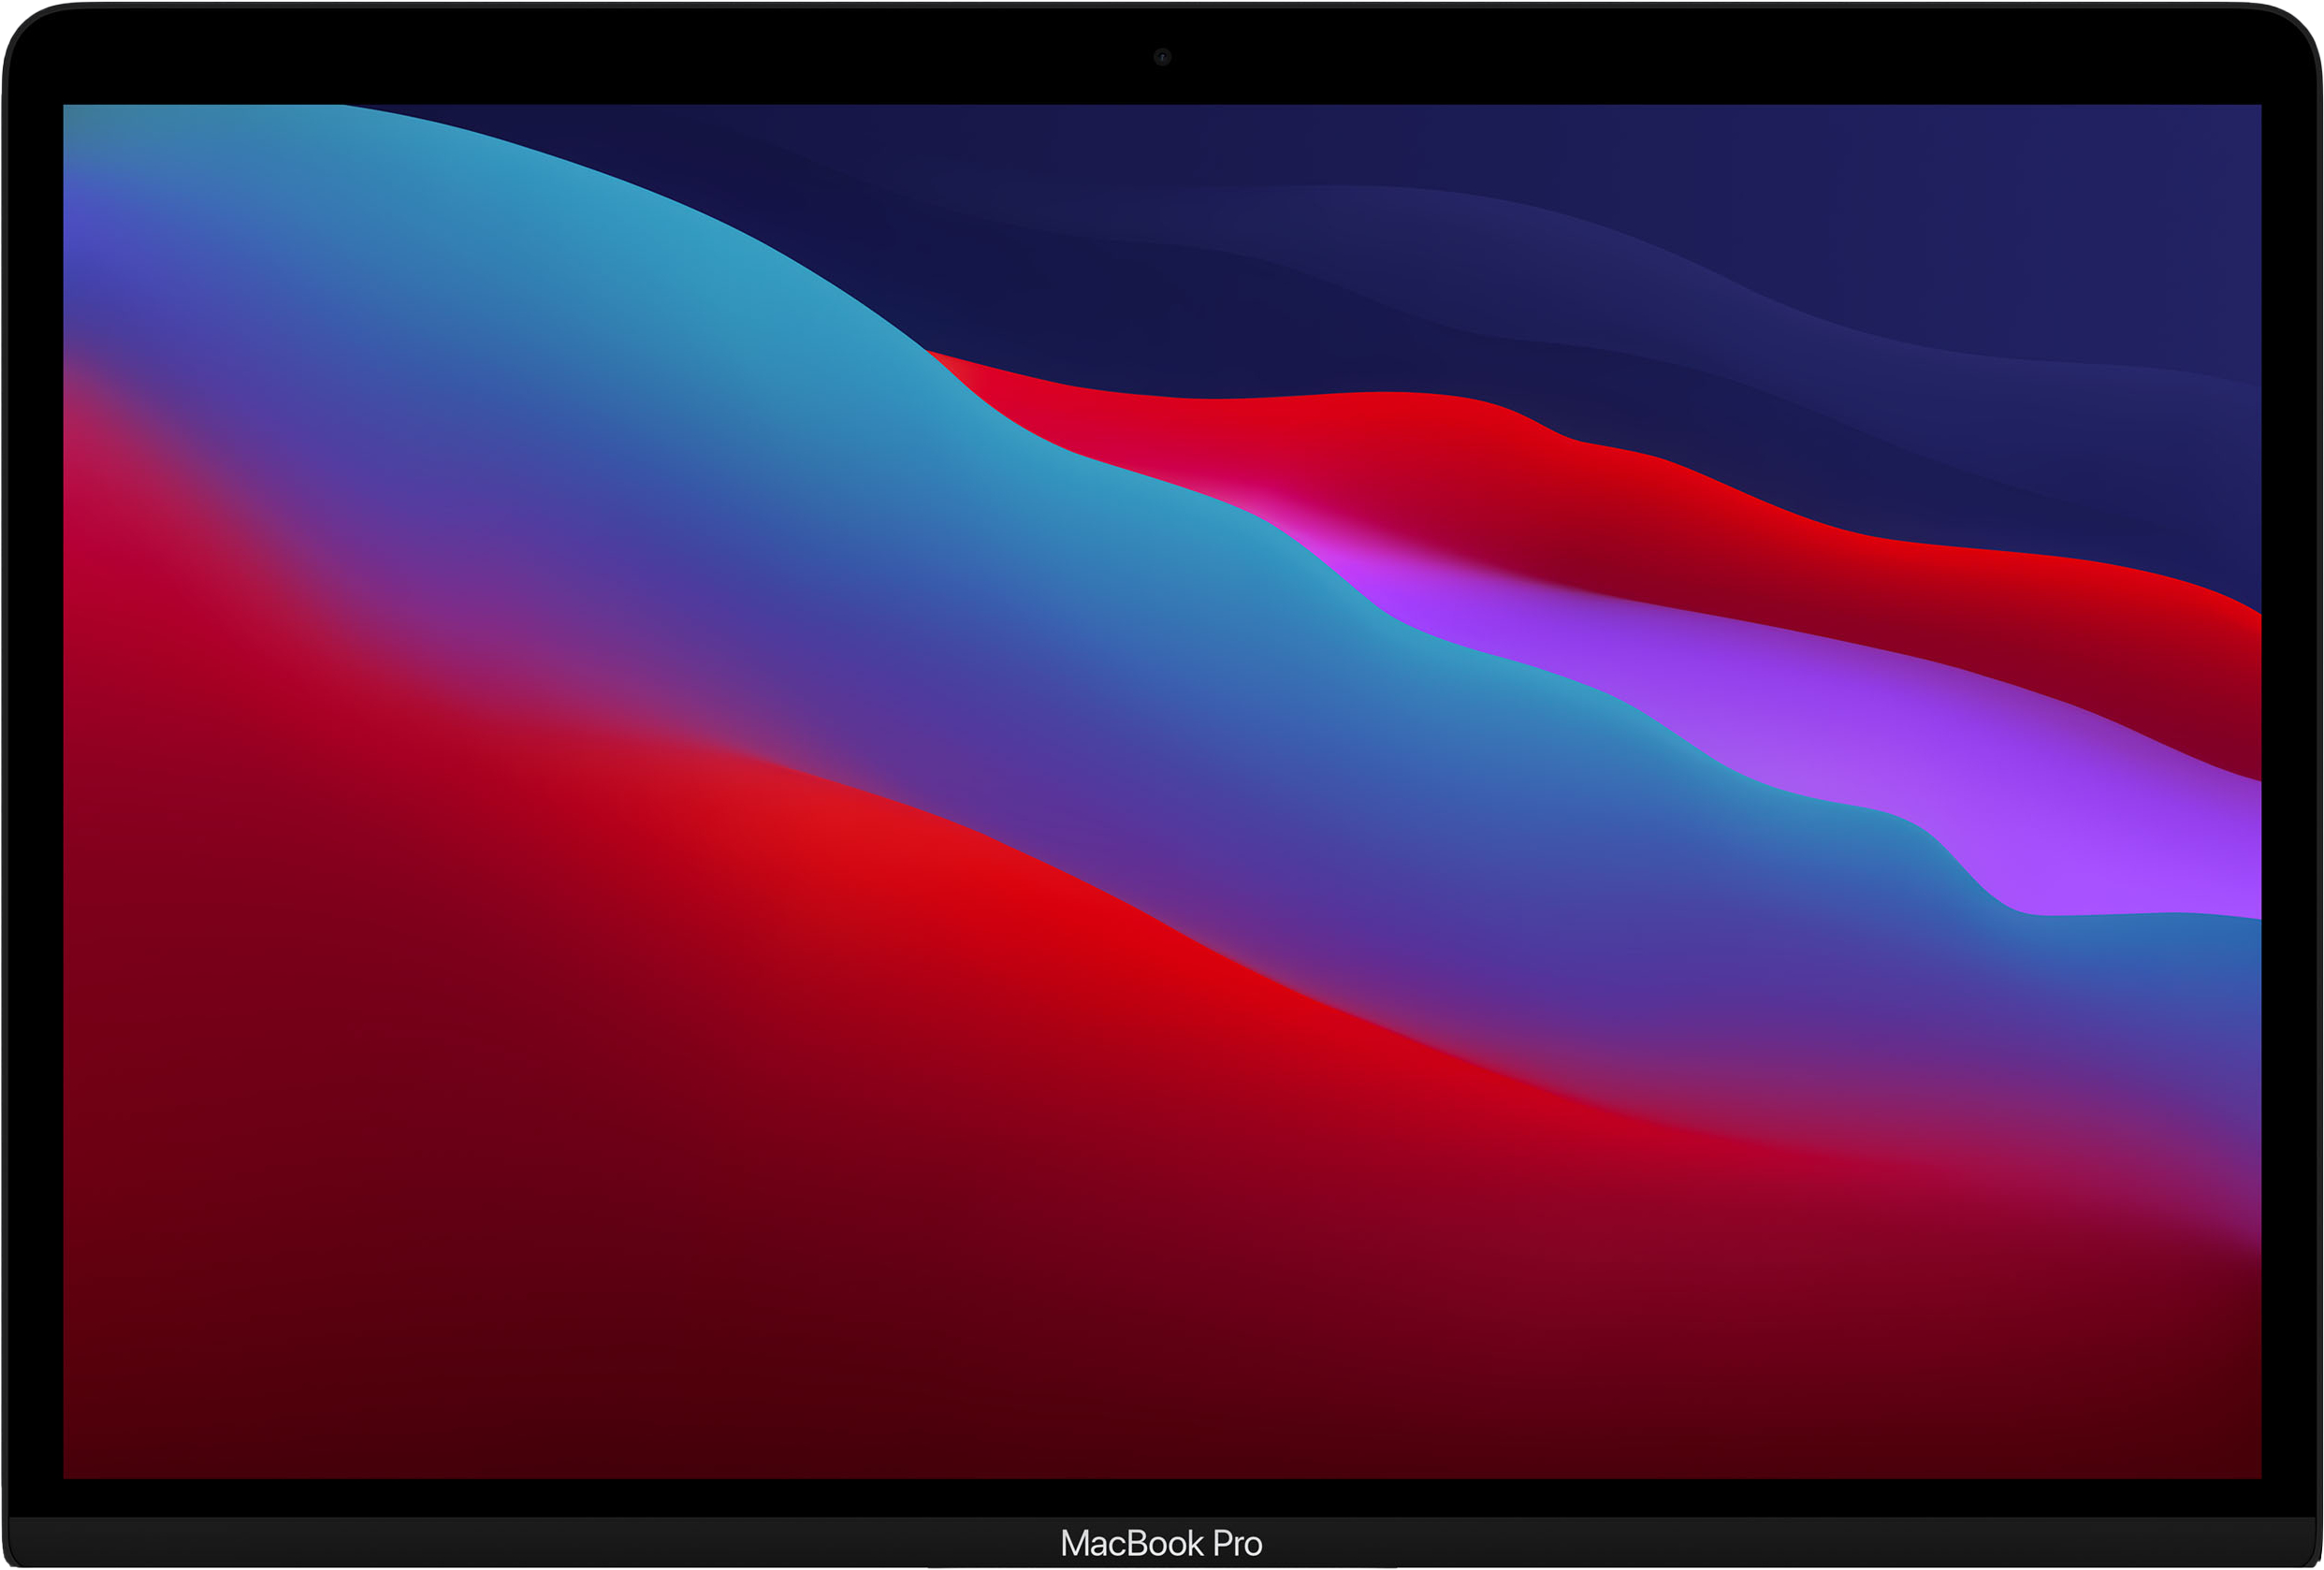
A WONDERFUL WORLD OF ARM

Slide 7
28000000000
ARM IS EVERYWHERE!

Slide 8

Arm—our future!
Today, it is the most perspective technology, future is in your pocket!

Slide 9
Thanks for the attention!

